Slide 1
UIUC GPA
By Group Wood: Allison Quinlan, Junting Wang, Austin Camps, Brian Ke

Slide 2
Project Description By Brian Ke
Objective
Our main purpose of this project is to use different information from the University of Illinois' GPA Dataset to predict the overall GPA value per class.
Given 8 data features, namely: 1. Year, 2. Term, 3. Subject, 4. Course Number, 5. Course Title, 6. Scheduled Type, 7. Grade (“F” through “A+”), and 8. Primary Instructor,
we can hopefully predict the GPA distribution of UIUC courses.

Slide 3
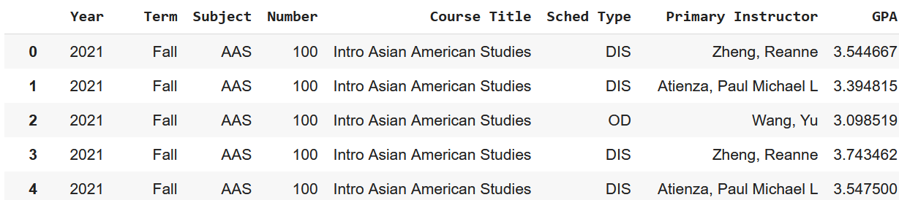
Milestone 1: Data Cleaning By Allison
We wanted to predict GPA, but only given grade distribution, so GPA must be calculated
How to deal with categorical data?
As suggested by the prompt, we made one copy of the data using one hot vectors
Since this created a massive dataframe, also saved it using ordinal encoding

Slide 4
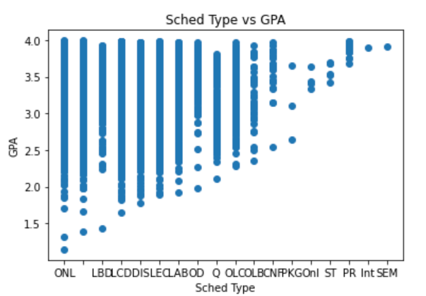
Milestone 2: Visualizations By Austin Camps
The visualizations gave valuable insight into the relationships between the GPA and various different parameters.
Some had a clear relationship

Slide 5
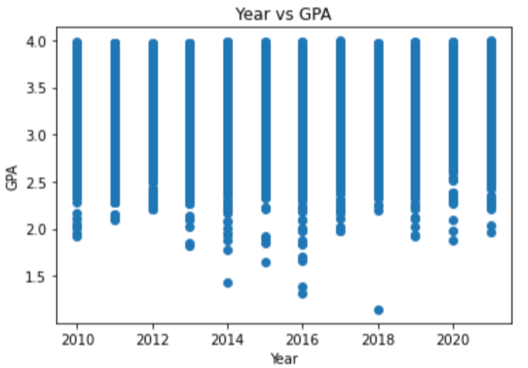
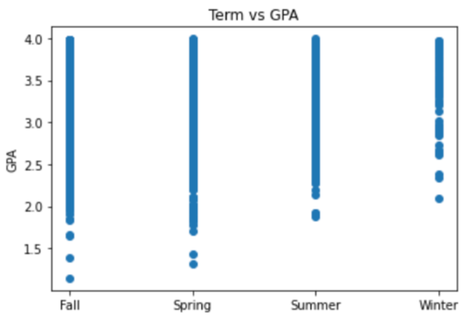
Milestone 2: Visualizations By Austin Camps

Slide 6
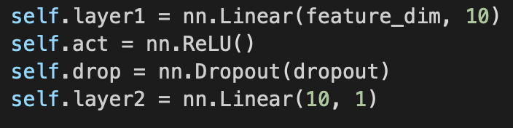
Milestone 3: Neural Networks, By Junting Wang
Dataset Statistics
Model Architecture
Training | Validation | Testing
7000 | 1000 | 2000

Slide 7
Milestone 3: Neural Networks, By Junting Wang
Experimental Results
 | MSE
lr=0.01, batch_size=1000, dropout=0.3 | 0.18
lr=0.01, batch_size=2000, dropout=0.3 | 0.15
lr=0.01, batch_size=2000, dropout=0.5 | 0.17
lr=0.01, batch_size=7000, dropout=0.3 | 5.93

Slide 8
Conclusions By Brian Ke
Results
After repeatedly testing and adjusting our model, the optimal parameter was set to Learning Rate= 0.01, Batch Size= 2000 and Dropout Rate= 0.7, while using ReLU as the activation function and Adam as the optimizer. For the test dataset prediction, our model yields an MSE of about 0.15.
The performance of our neural network model is similar to using linear regression, which also yields an MSE around 0.15. For future development, we can consider using more complex neural network models if wish to effectively reduce the prediction error.

Slide 9
Thanks for listening!

